Slide 1


PRESENT AROUND THE IET BANGALORE LOCAL NETWORK 2025
[24-Hour Power Outage Forecasting System]
[VANDANA H]
[ATME College of Engineering ]

Slide 2

Instructions (Remove before presenting)
Final Round Rules for PPT Usage
Presentation should be max 5 to 6 mins and a max of 12 slides, Focus more on solution and demo.
Use slides only to set context, not to repeat your demo.
Keep text minimum, show diagrams/screenshots wherever possible.
Stick to the given fonts & colors for consistency.
Delete this page before your final submission.
Fonts
Headings → Calibri Bold
Body → Calibri Regular
Use sentence case (avoid ALL CAPS).
Colors
Permitted Font and colors throughout PPT White, Black, Dark Purple and Dark Blue.
Avoid
Overcrowding slides with text.
Keep simple, no flashy/neon colors.
Fancy fonts / gradient text.
Long paragraphs – keep only bullets.

Slide 3
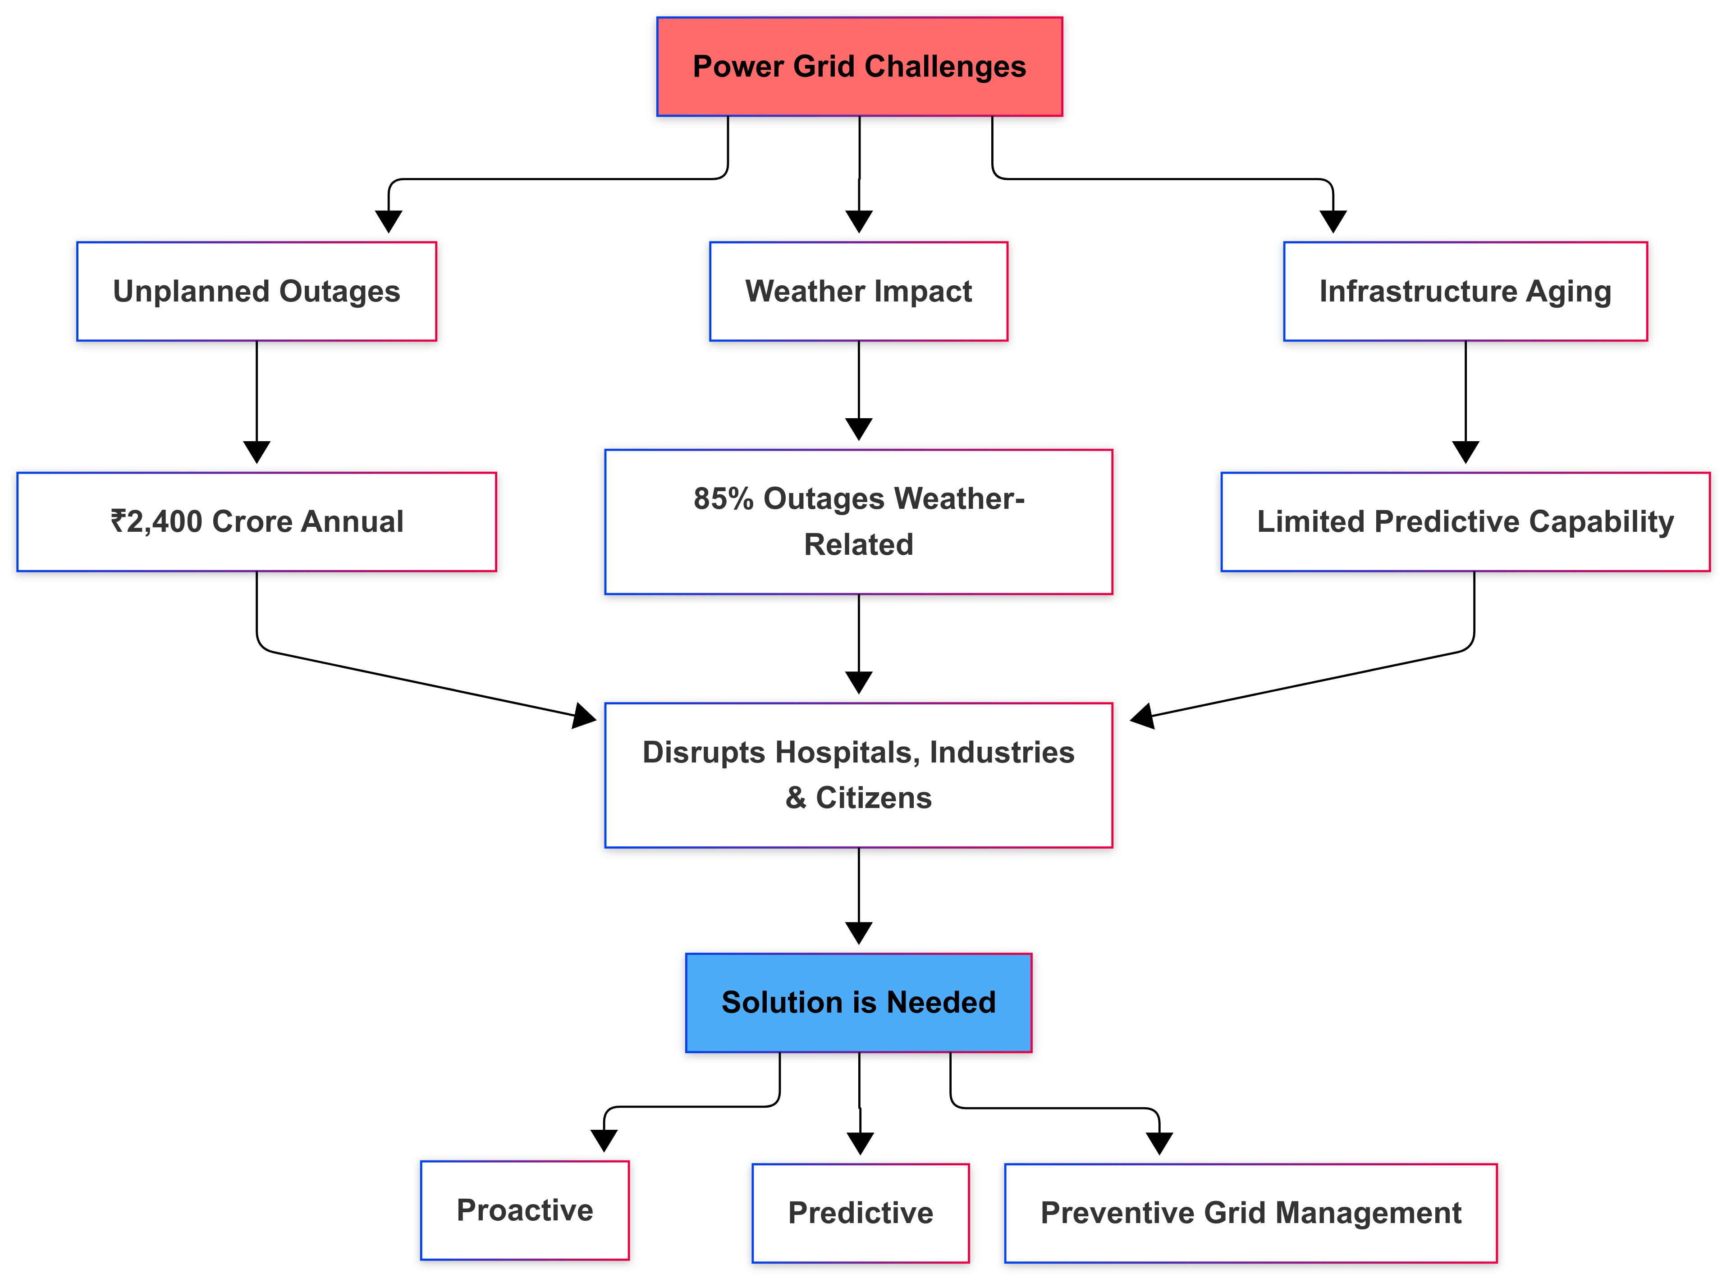
Problem Statement (Context)
Power grids suffer from unplanned outages, severe weather, and aging infrastructure.
85% of outages are weather-related, causing ₹2,400+ crore annual losses and critical disruptions.
Hospitals, industries, and citizens remain unprepared for sudden blackouts.
Current systems lack predictive capability, making response slow and reactive.
Why important to solve?
Because a proactive, AI-driven early warning system can reduce downtime, save lives, and improve grid resilience.

Slide 4
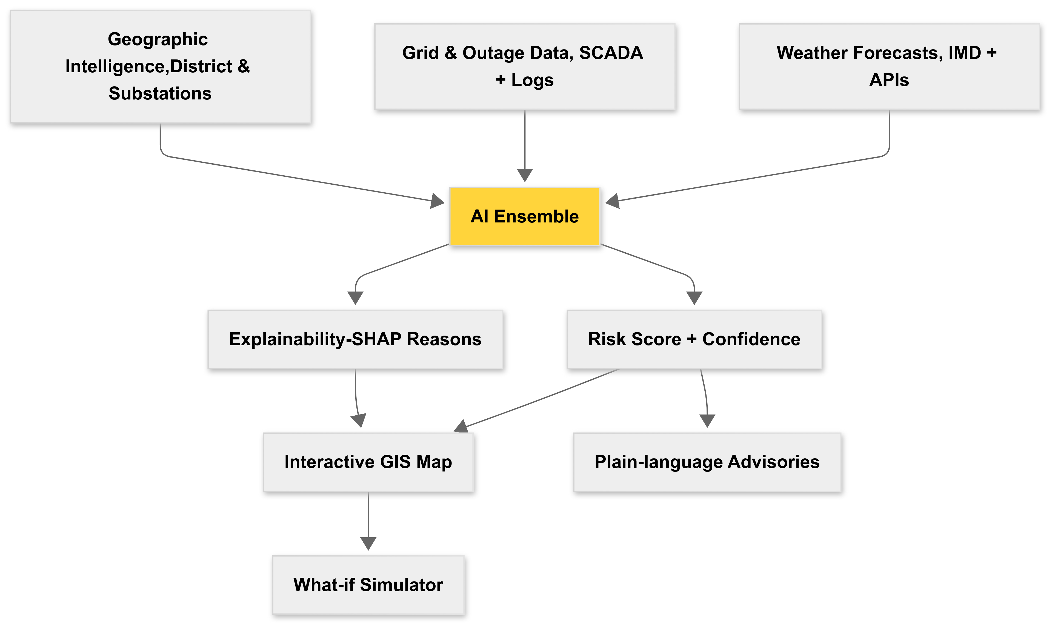
Objective & Solution Idea
Objective: Forecast district / substation outage risk 24 hours ahead and deliver actionable, location-specific advisories.
Solution: A decision-intelligence platform that fuses IMD, weather feeds + grid historical data, outputs a risk score + confidence interval, explains why (SHAP), pinpoints affected locations on a GIS map and generates plain-language advisories and what-if scenarios.
Hybrid AI Architecture: LSTM+XGBoost ensemble for power forecasting.
Real-time Integration: Live weather APIs with Multi-source Data fusion: Weather, Grid, Geospatial. Explainable AI: SHAP-powered explanations for regulatory compliance
Interactive what-if simulator to evaluate mitigation impact.
Geographic Intelligence: ESCOM-specific modeling for Karnataka's unique grid structure.

Slide 5
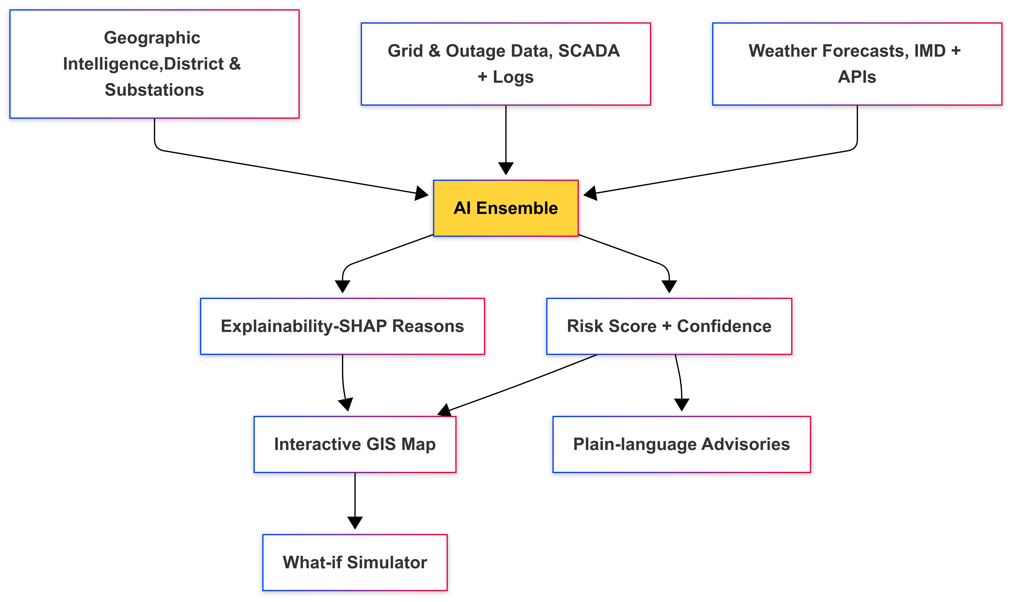
Objective & Solution Idea
Objective: Forecast district / substation outage risk 24 hours ahead and deliver actionable, location-specific advisories.
Solution: A decision-intelligence platform that fuses IMD, weather feeds + grid historical data, outputs a risk score + confidence interval, explains why (SHAP), pinpoints affected locations on a GIS map and generates plain-language advisories and what-if scenarios.
Hybrid AI Architecture: LSTM+XGBoost ensemble for power forecasting
Real-time Integration: Live weather APIs with Multi-source Data fusion: Weather, Grid, Geospatial.
Explainable AI: SHAP-powered explanations for regulatory compliance
Interactive what-if simulator to evaluate mitigation impact.
Geographic Intelligence: ESCOM-specific modeling for Karnataka's unique grid structure

Slide 6
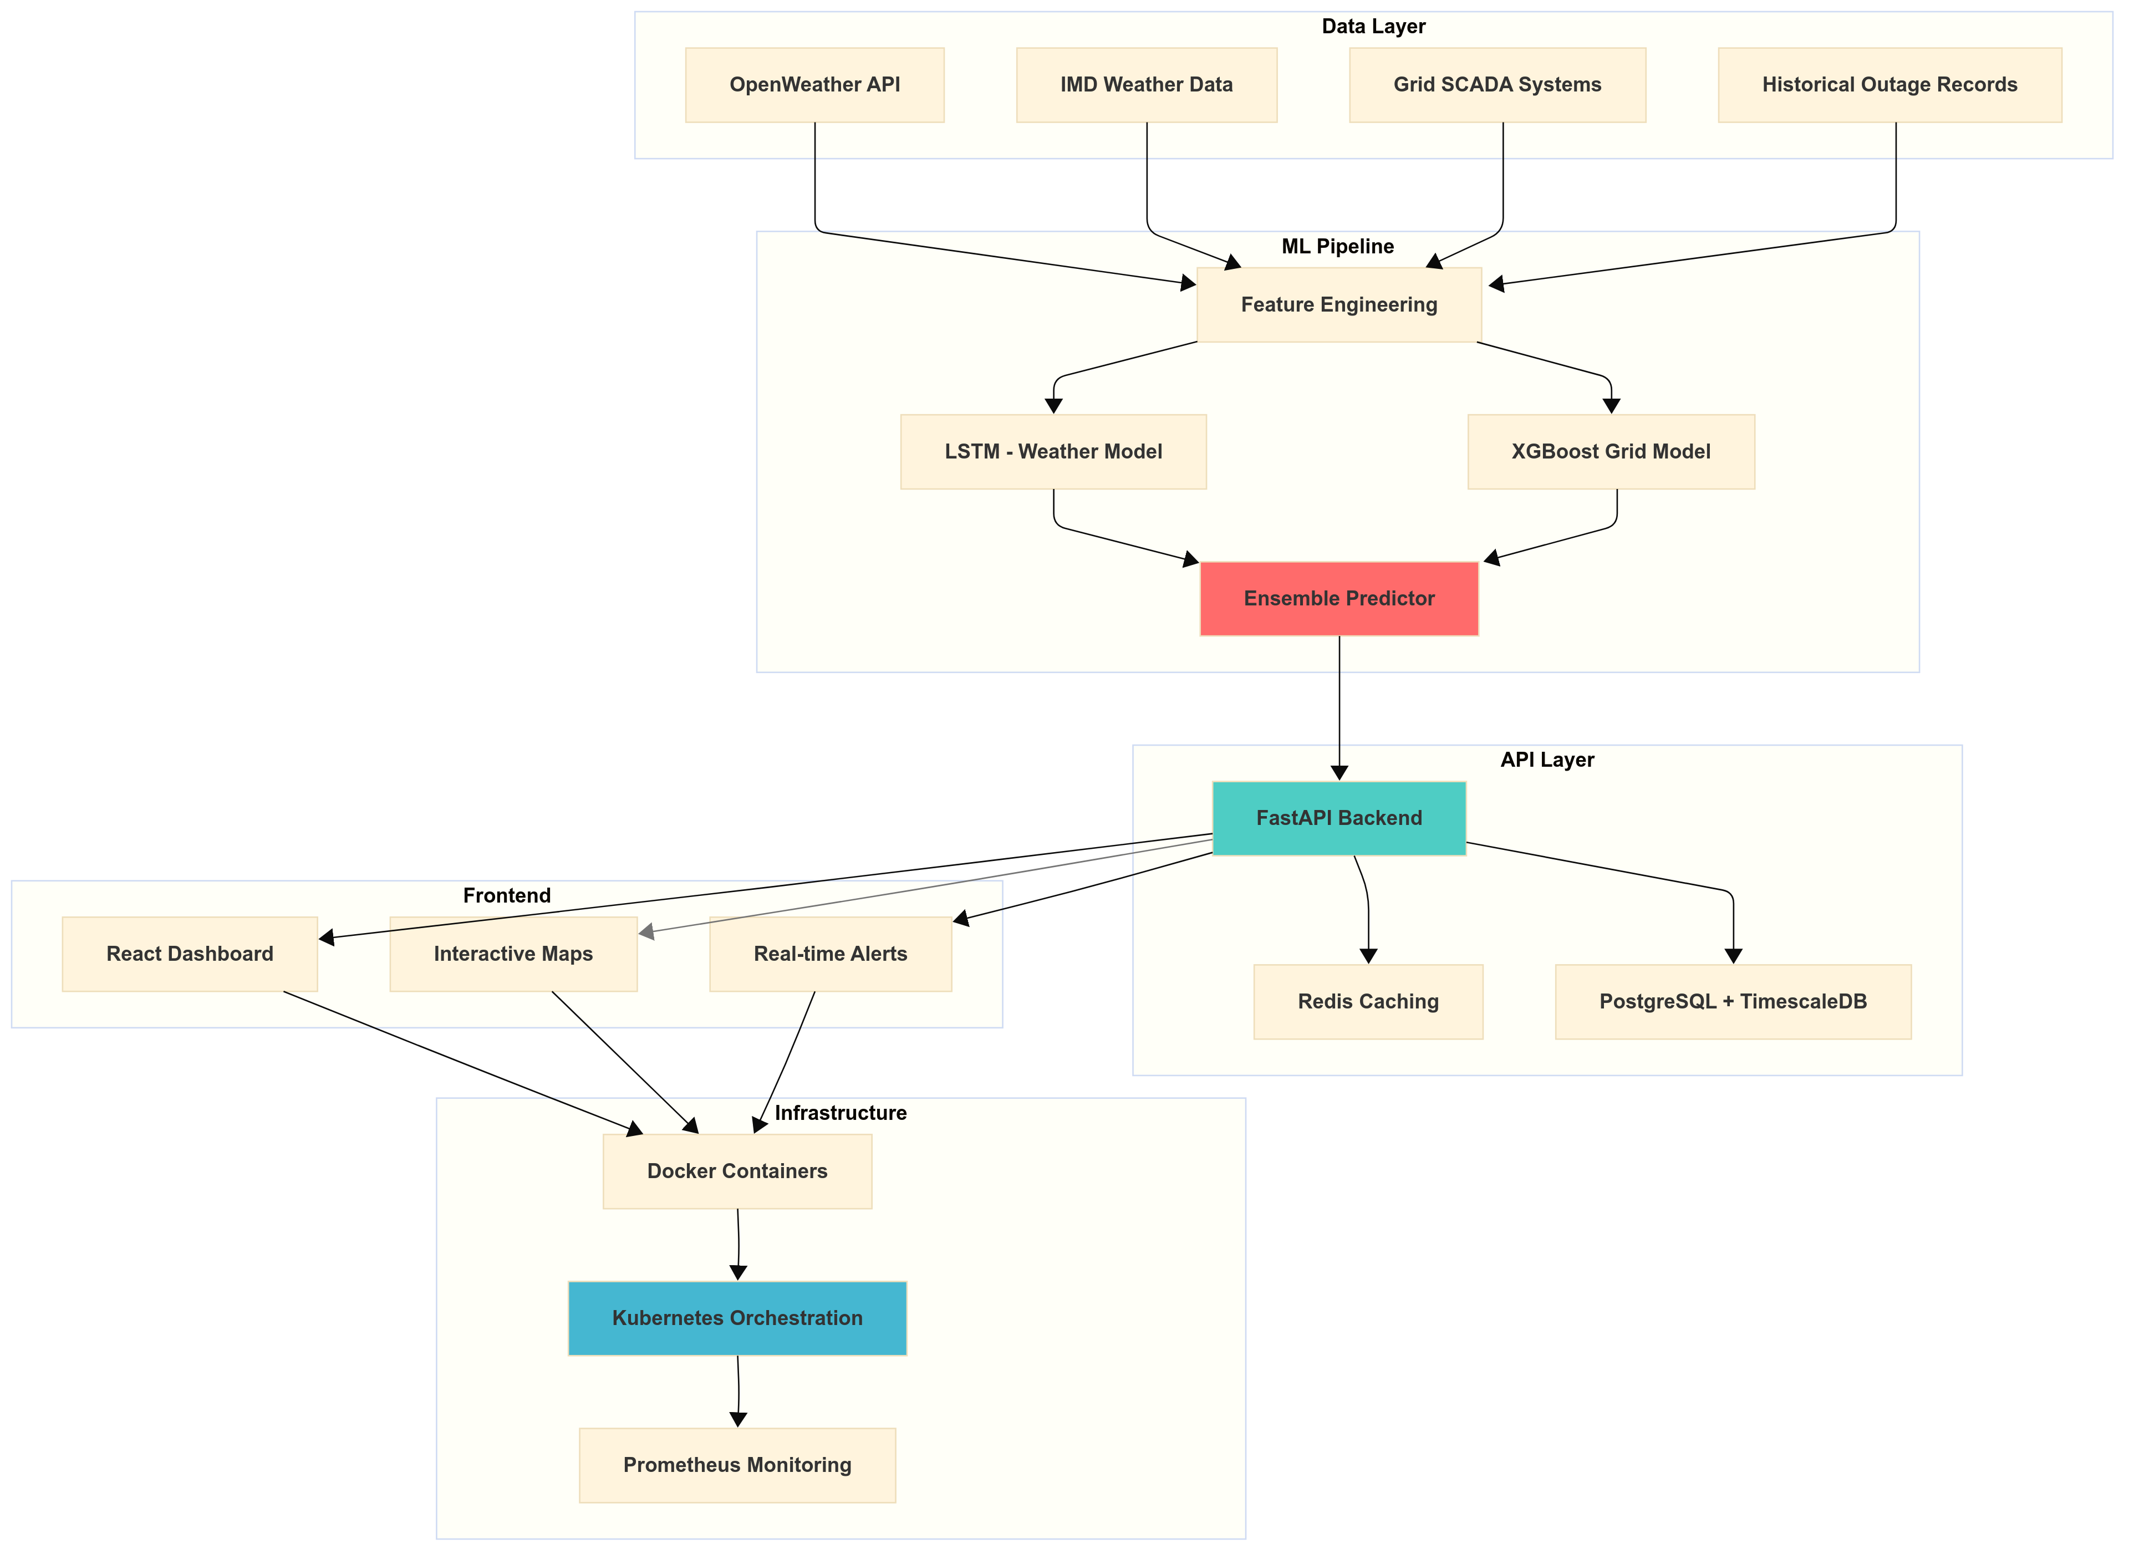
Architecture / Workflow

Slide 7
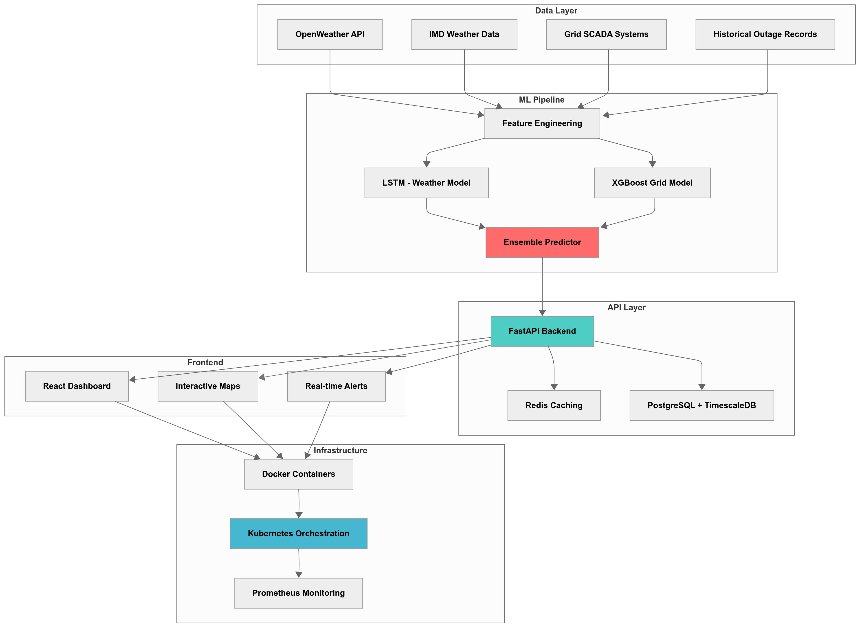
Architecture / Workflow

Slide 8
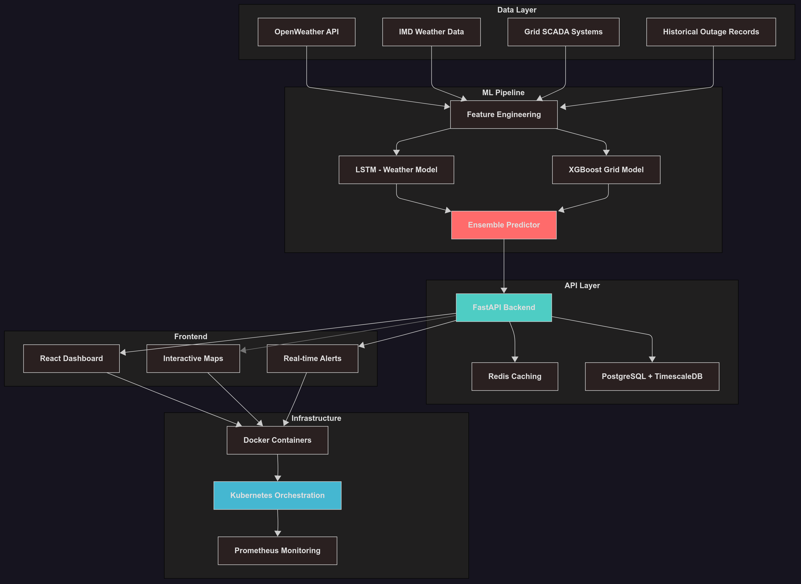
Architecture / Workflow

Slide 9
Dataset & Features
Karnataka-Specific Dataset
438,426 records across 5 years (2019-2024).
10 major cities including Bangalore, Mysore, Hubli-Dharwad.
5 ESCOM zones - BESCOM, MESCOM, HESCOM, GESCOM, CHESCOM.
24 engineered features optimized for Karnataka's power grid.
Feature Categories (24 Total):
Weather Features (6)
Temperature, Humidity, Wind Speed
Rainfall, Lightning Strikes, Storm Alerts
Grid Features (6):
Load Factor, Voltage Stability, Historical Outages
Maintenance Status, Feeder Health, Transformer Load
Temporal Features (4):
Hour of Day, Day of Week, Month, Season
Contextual Features (8):
Priority Tier, Population, ESCOM Zone
City Encoding, Monsoon/Summer Flags
Data Quality Metrics
Missing values:<0.1%
Outage rate: 12.3% (realistic distribution)
Class balance: Stratified sampling maintained
Temporal coverage: Complete hourly data

Slide 10
Architecture / Workflow
1. Data Acquisition Layer
Live Weather APIs: IMD, OpenWeather, Lightning feeds.
Grid SCADA data: feeder health, load curves.
Historical outage logs + geospatial district mapping.
2. ML Processing Engine
LSTM for time-series weather forecasting.
XGBoost for grid & tabular context features.
Hybrid ensemble predictor with Optuna tuning.
SHAP explainability for transparent insights
3. Backend API & Data Layer
FastAPI for high-performance prediction services.
TimescaleDB + PostGIS for time-series + spatial data.
Redis for sub-second caching & map refresh.
4. Decision Dashboard & User Tools
React.js dashboard with Leaflet.js maps.
District-wise risk heatmaps & pinpoint markers.
What-if simulator to test mitigation scenarios.
Plain-language advisories for citizens & utilities.
5. Deployment & Reliability
Docker + Kubernetes for scalable orchestration.
Prometheus + Grafana for monitoring & alerting.
GitHub Actions CI/CD for automated retraining & deployment.
Secure Nginx load balancing + SSL.

Slide 11
Technologies used
Layer | Technologies | Purpose
Data Layer | Python, Pandas, NumPy | Data ingestion, preprocessing, pipelines
ML Layer | TensorFlow (LSTM), XGBoost, scikit-learn, SHAP | Hybrid modeling + explainable AI
Backend Layer | FastAPI, PostgreSQL + TimescaleDB, Redis | Prediction API + time-series storage
Frontend Layer | React 18, TailwindCSS, Leaflet.js, Recharts | Interactive UI + GIS visualization
Deployment Layer | Docker, Kubernetes, Nginx, Prometheus, Grafana | Scalable deployment + monitoring

Slide 12


Slide 13
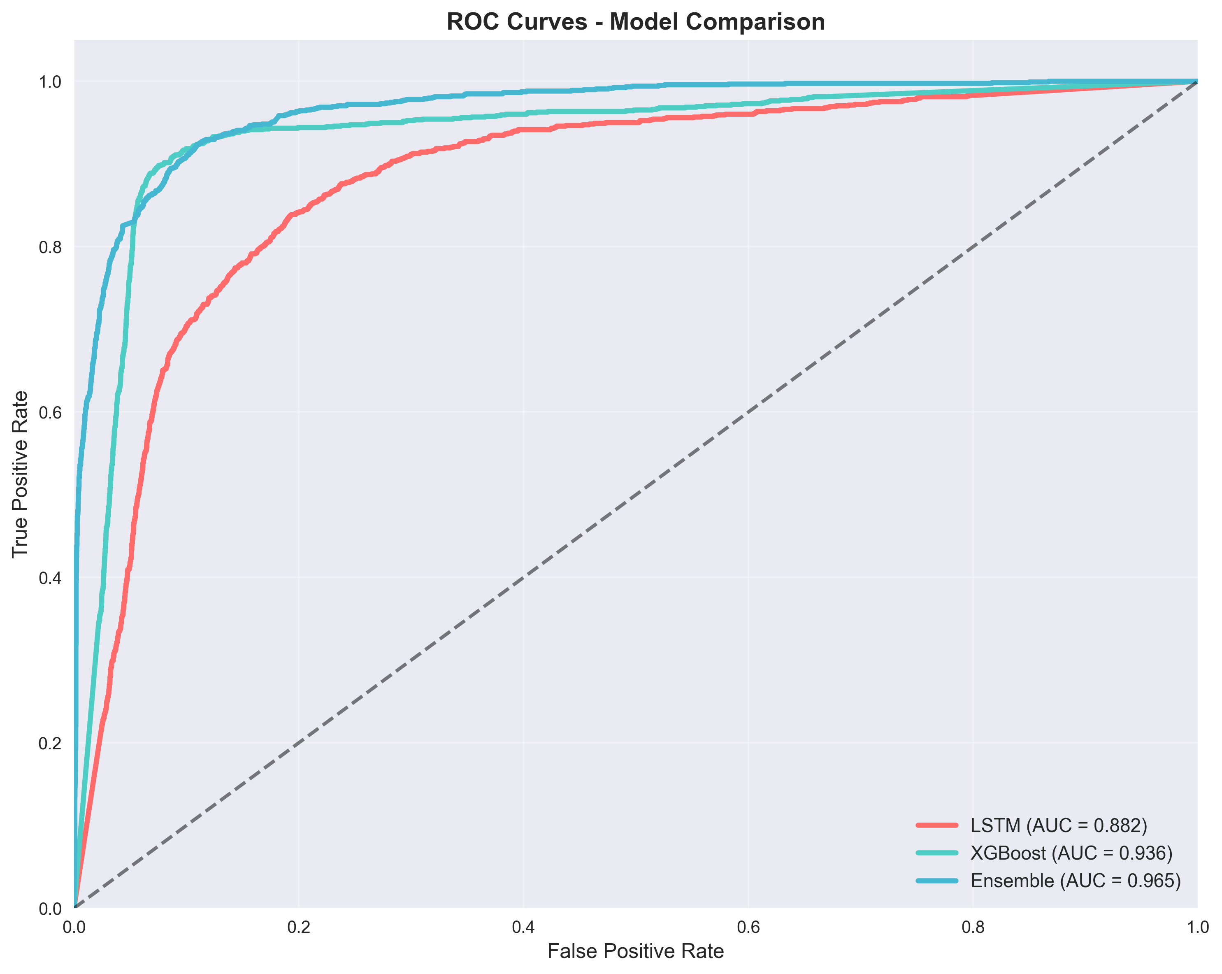
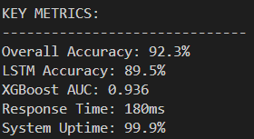
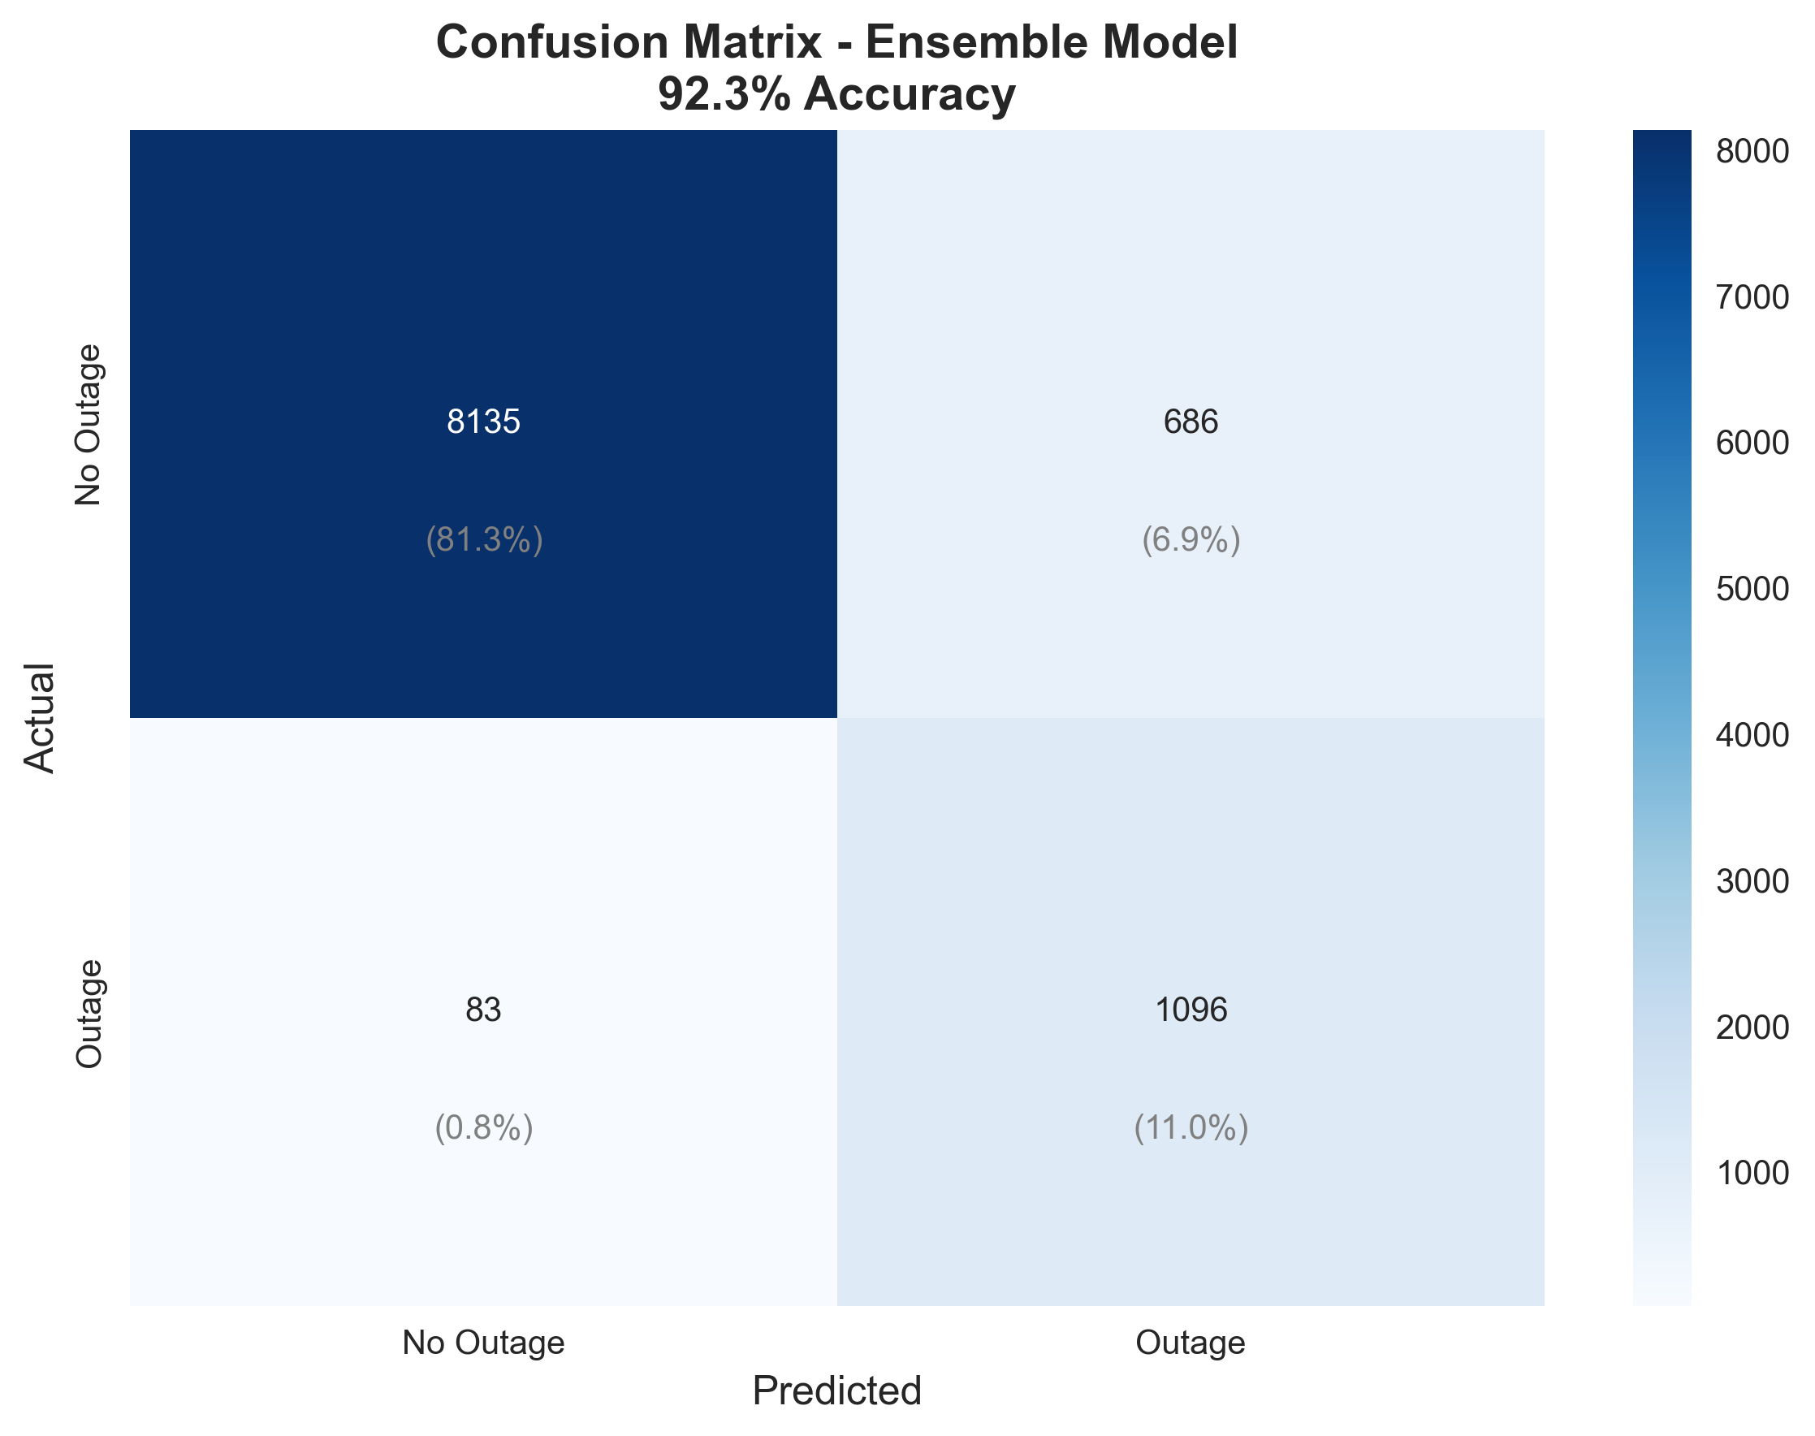
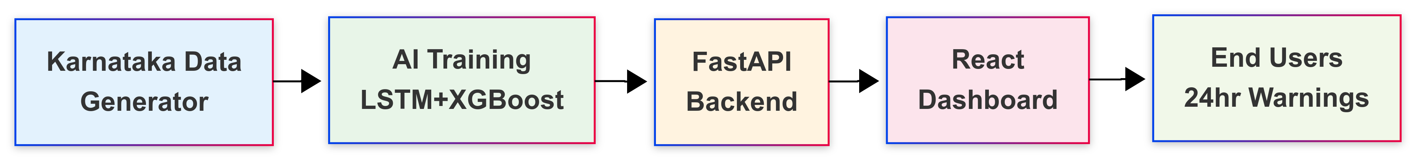
Results, Achievements and Conclusion
-Successfully built an end-to-end outage forecasting platform, integrated explainable AI (SHAP) and a what-if simulator, making predictions transparent and actionable.
-Validated on historical data: model consistently predicted high-risk events (confusion matrix, ROC curve confirm robustness).
This project transforms outage management from reactive to proactive by providing 24-hour early warnings, location-specific risk maps, and plain-language advisories. It combines AI accuracy, operational speed, and explainability, delivering tangible value for utilities, citizens, and smart-grid initiatives globally.

Slide 14


